Slide 1
FAKE NEWS DETECTION IN SOCIAL MEDIA WITH CONVOLUTIONAL NEURAL NETWORK
Presented by: RISHI VARADAN.V.S
III year,KVCET
NM ID-au421221243032
Email ID-varadanrishi@gmail.com

Slide 2
PROPOSED SYSTEM
In this proposed work, we aim to leverage the power of Convolutional Neural Networks (CNNs) to automatically detect fake news in social media content. By training a CNN model on a large dataset of labeled fake and real news articles, we seek to develop an efficient and scalable solution for identifying misinformation in real-time. Our approach will involve preprocessing social media posts, extracting relevant features, and training the CNN model to classify posts as either fake or real. We anticipate that this research will contribute to the development of more effective tools for combating the spread of fake news online.

Slide 3
PROBLEM STATEMENT
The dissemination of fake news through social media platforms has become a pervasive issue, undermining the integrity of online information and impacting public opinion. Manual detection methods are slow and inefficient, leading to the need for automated solutions to identify and mitigate the spread of misinformation. However, existing approaches often lack accuracy and scalability, necessitating the development of more effective techniques.
Data Heterogeneity
Feature Extraction
Model Generalization

Slide 4
PROPOSED SOLUTION
1. Data Collection and Preprocessing: Gather a large dataset of labeled social media posts, including text, images, and videos, from various platforms. Preprocess the data to remove noise, handle missing values, and standardize formats for consistency.
2. Feature Extraction: Utilize techniques such as word embeddings (e.g., Word2Vec, GloVe) and image embeddings (e.g., pre-trained CNN models like ResNet, VGG) to extract meaningful features from textual and multimedia content. This step is crucial for representing the diverse information present in social media posts effectively.
3. Model Architecture: Design a CNN architecture capable of processing both textual and visual features simultaneously. The model should consist of multiple convolutional layers followed by pooling layers to capture hierarchical patterns in the data. Incorporate techniques like attention mechanisms to focus on informative regions within images or segments of text.

Slide 5
4. Training and Evaluation: Split the dataset into training, validation, and testing sets. Train the CNN model using backpropagation and optimize hyperparameters through techniques like grid search or random search. Evaluate the model's performance using metrics such as accuracy, precision, recall, and F1-score on the test set to ensure robustness and generalization.
5. Integration and Deployment: Integrate the trained CNN model into a scalable and efficient pipeline for real-time fake news detection on social media platforms. Implement APIs or SDKs to facilitate seamless integration with existing systems or third-party applications. Ensure compliance with privacy regulations and ethical guidelines throughout the deployment process.
6. Continuous Improvement: Monitor the model's performance over time and collect user feedback to identify areas for improvement. Continuously update the model by retraining on new data and incorporating state-of-the-art techniques to adapt to evolving trends and challenges in fake news detection.

Slide 6
SYSTEM APPROACH
System Requirements:
Hardware: High-performance CPUs or GPUs to handle the computational load of training and inference tasks associated with Convolutional Neural Networks (CNNs).Sufficient RAM to accommodate large datasets and model parameters during training.Adequate storage capacity for storing datasets, pre-trained models, and intermediate results generated during the training process.Fast storage devices (e.g., SSDs) to minimize data access latency and facilitate rapid model development.Stable internet connectivity for accessing external data sources, downloading pre-trained models, and deploying the final solution on cloud platforms or web servers.
Software:
1. Operating System: Compatible operating systems such as Linux (e.g., Ubuntu, CentOS) or Windows for running deep learning frameworks and associated software tools.
2. Deep Learning Frameworks: Installation of deep learning frameworks such as TensorFlow, PyTorch, or Keras for building and training Convolutional Neural Networks. - Ensure compatibility with the chosen framework version and maintain consistency across development and deployment environments.

Slide 7
3. Development Environment: Integrated Development Environment (IDE) such as Jupyter Notebook, PyCharm, or Visual Studio Code for writing, debugging, and testing code. Version control systems (e.g., Git) for managing project codebase and collaborating with team members efficiently. 4. Data Processing and Analysis Tools: Libraries like Pandas, NumPy, and scikit-learn for data preprocessing, feature extraction, and evaluation of model performance. Image processing libraries (e.g., OpenCV) for handling multimedia data and performing operations like resizing, cropping, and normalization. 5. Deployment Tools: Containerization tools like Docker for packaging the developed solution into lightweight and portable containers. Orchestration frameworks such as Kubernetes for managing containerized applications at scale and ensuring high availability. 6. Monitoring and Logging: Logging libraries (e.g., Log4j, Python logging module) for recording runtime information, errors, and debugging messages. Monitoring tools (e.g., Prometheus, Grafana) for tracking resource utilization, performance metrics, and system health during training and deployment phases. 7. Security and Privacy: Implementation of security measures such as encryption, access controls, and authentication mechanisms to safeguard sensitive data and prevent unauthorized access.Adherence to privacy regulations (e.g., GDPR) and ethical guidelines governing the collection, storage, and processing of user data in social media applications.

Slide 8
ALGORITHM AND DEPLOYMENT
Data exploration: In the data exploration phase of the fake news detection project, the dataset, comprising social media posts labeled as fake or real news, is first inspected to understand its structure and distribution. Text analysis techniques are applied to identify common patterns and trends, while visualization methods such as histograms and word clouds reveal insights into word frequencies and vocabulary usage. Features are engineered from text, images, and videos, and potential class imbalances are addressed. Correlation analysis uncovers relationships between features, and topic modeling techniques reveal latent topics within the text content. Sentiment analysis helps understand emotional tones in the posts. Finally, data cleaning ensures the dataset is free of noise and inconsistencies, laying the foundation for subsequent modeling steps.
Problem formulation:Given a dataset of social media posts labeled as either fake or real news, the objective is to develop a machine learning model, specifically Convolutional Neural Networks (CNNs), capable of accurately classifying new social media posts as fake or real. The input data consists of textual content, images, and videos from various social media platforms. The model's output is a binary classification indicating whether a given post contains fake or real news. The goal is to create a reliable and scalable solution for identifying misinformation in social media content, contributing to the mitigation of the spread of fake news online.

Slide 9
Algorithm selection: 1. CNN Architecture: Select a CNN architecture suitable for processing textual and visual features simultaneously. One common approach is to use a combination of convolutional and pooling layers followed by fully connected layers. Alternatively, consider architectures like VGG, ResNet, or Inception, which have been pretrained on large image datasets and can be fine-tuned for fake news detection tasks. 2. Word Embeddings: Incorporate word embeddings such as Word2Vec, GloVe, or FastText to represent the textual content of social media posts as dense vectors. These embeddings capture semantic relationships between words and help the model understand the meaning of the text. 3. Image Embeddings: Utilize pre-trained CNN models (e.g., VGG, ResNet) to extract image embeddings from social media post images. These embeddings capture visual features relevant to fake news detection, such as image context and content. 4. Training Methodology: Train the CNN model using a combination of real and fake news data. Apply techniques like data augmentation to increase the diversity of the training dataset and reduce overfitting. Use appropriate loss functions (e.g., binary cross-entropy) and optimization algorithms (e.g., Adam, SGD) to train the model effectively. 5. Hyperparameter Tuning: Fine-tune hyperparameters such as learning rate, batch size, and dropout rate to optimize the model's performance. Perform grid search or random search to explore the hyperparameter space and identify the best configuration.

Slide 10
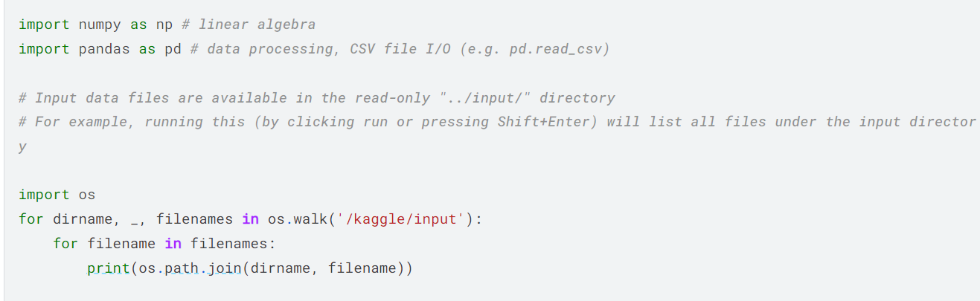
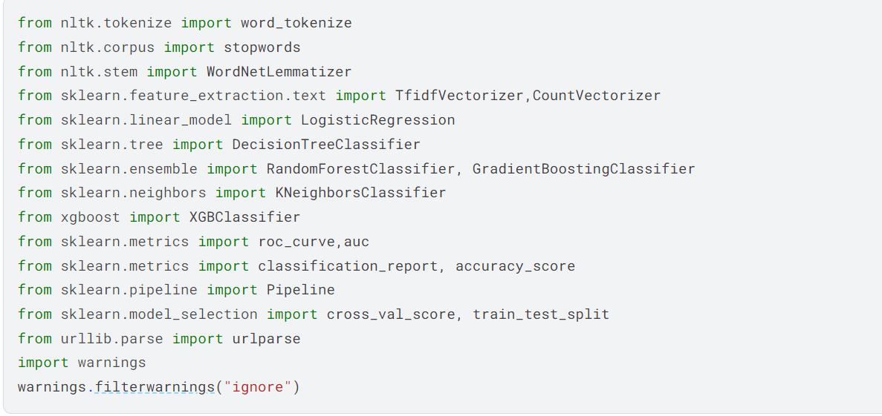
TRAINING AND PROCESS
import libraries:

Slide 11
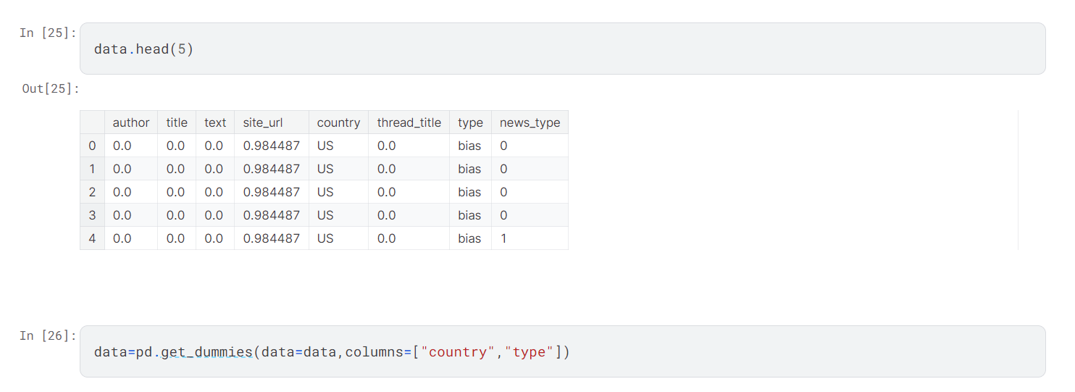
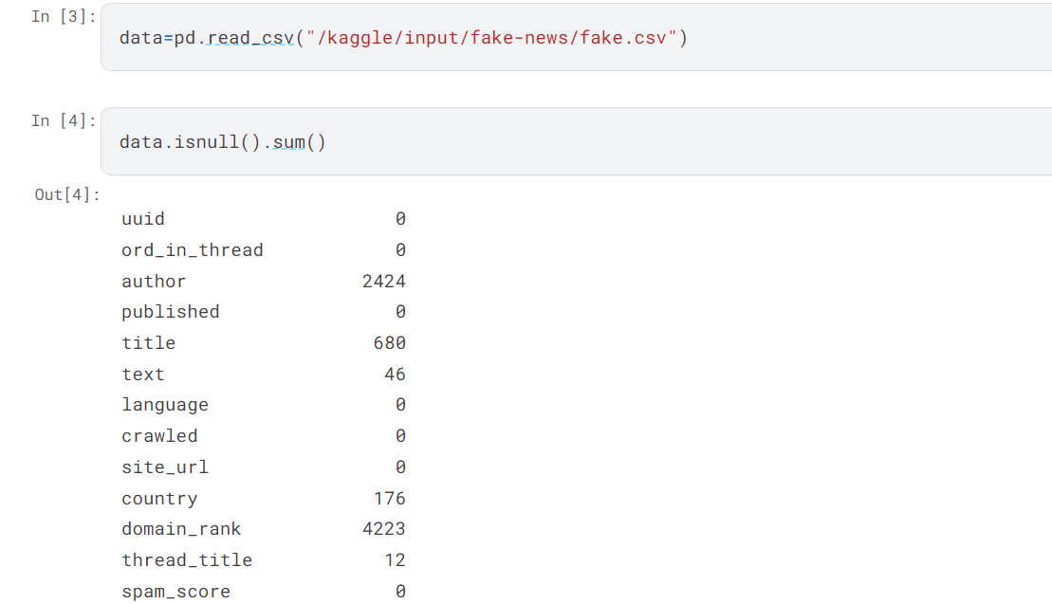
DATA PRE-PROCESSING

Slide 12
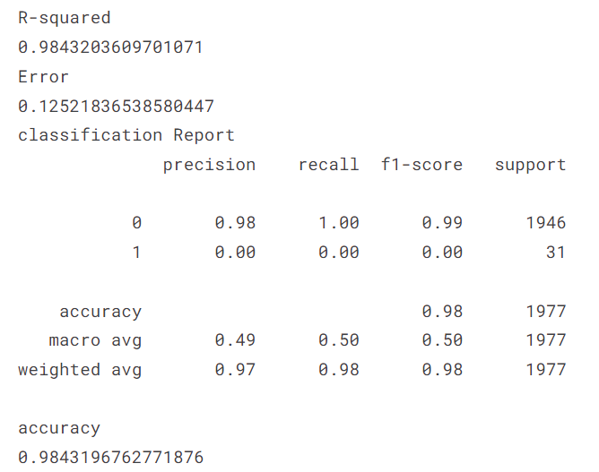
RESULT

Slide 13
CONCLUSION
In conclusion, the project on "Fake News Detection in Social Media with Convolutional Neural Networks" represents a crucial step towards combating the spread of misinformation online. By leveraging advanced machine learning techniques, particularly Convolutional Neural Networks (CNNs), the project aims to develop an automated system capable of identifying fake news in social media content.
Through extensive data collection, preprocessing, feature extraction, and model training, the project endeavors to build a robust and scalable solution for detecting fake news across diverse social media platforms. The proposed CNN architecture, combined with state-of-the-art methodologies for model evaluation and deployment, holds the potential to significantly enhance the accuracy and efficiency of fake news detection efforts.

Slide 14
FUTURE SCOPE
1. Multi-modal Analysis: Extend the project to incorporate additional modalities such as audio, video, and user engagement signals to improve the comprehensiveness of fake news detection.
2. Adversarial Robustness: Investigate techniques for enhancing the robustness of the CNN model against adversarial attacks and manipulative content.
3. Real-time Detection: Develop real-time detection capabilities to enable timely interventions and mitigation strategies in response to the rapid dissemination of fake news.
4. Explainable AI (XAI): Integrate explainability methods to provide transparency and interpretability in model predictions, fostering user trust and understanding.
5. Cross-disciplinary Collaboration: Collaborate with experts from diverse fields such as sociology, psychology, and political science to gain deeper insights into the socio-cultural factors influencing fake news propagation.
6. Global Collaboration: Foster collaboration with international stakeholders to address the global challenge of fake news and promote information integrity across different regions and languages.

Slide 15
REFERENCES
Wang, W., Chen, L., & Thirunarayan, K. (2020). "Fake news detection on social media: A data mining perspective." ACM SIGKDD Explorations Newsletter, 21(2), 80-91.
Gupta, R., & Agrawal, R. K. (2020). "Fake news detection using deep learning techniques: A systematic review." Multimedia Tools and Applications, 79(47-48), 35429-35458.
Shu, K., Mahudeswaran, D., & Liu, H. (2019). "Fake news detection on social media: A data mining perspective." ACM SIGKDD Explorations Newsletter, 21(1), 22-36.
Castillo, C., Mendoza, M., & Poblete, B. (2011). "Information credibility on Twitter." In Proceedings of the 20th international conference on World wide web (pp. 675-684).
Zubiaga, A., & Ji, H. (2014). "Distributed data stream classification for twitter spam and bot detection." In Proceedings of the 23rd ACM International Conference on Conference on Information and Knowledge Management (pp. 229-238).
- GitHub repositories of related projects: Explore repositories containing code implementations, datasets, and documentation on fake news detection using CNNs.

